Slide 1
COMP 4500
Week 5 - Friday

Slide 2
Last time
What did we talk about last time?
Scheduling to minimize lateness
Dijkstra's algorithm
Started minimum spanning trees

Slide 3
Questions?

Slide 4
Back to MST

Slide 5
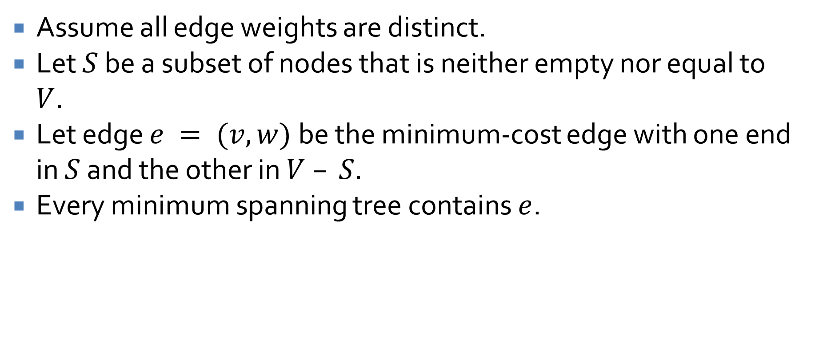
Cut Property
Assume all edge weights are distinct.
Let $S$ be a subset of nodes that is neither empty nor equal to $V$.
Let edge $e = (v,w)$be the minimum-cost edge with one end in $S$ and the other in $V – S$.
Every minimum spanning tree contains $e$.

Slide 6
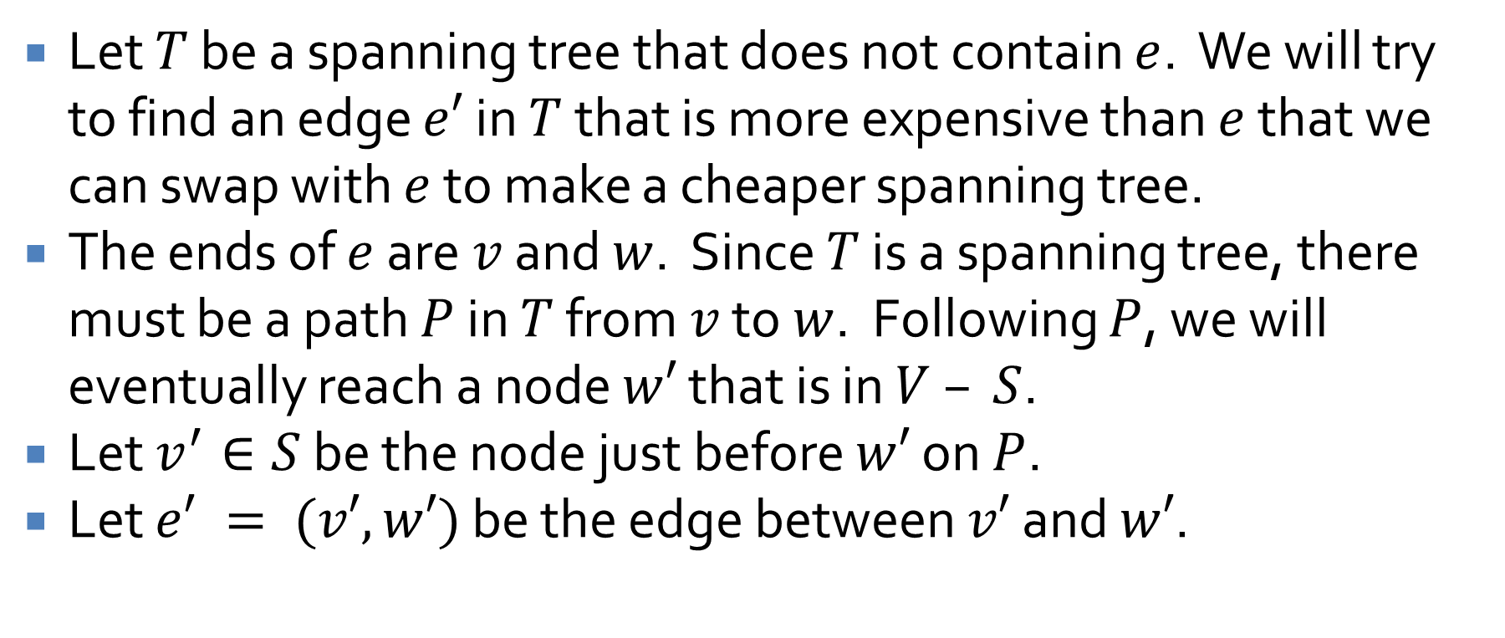
Proof of Cut Property
Let $T$ be a spanning tree that does not contain $e$. We will try to find an edge $e′$ in $T$ that is more expensive than $e$ that we can swap with $e$ to make a cheaper spanning tree.
The ends of $e$ are $v$ and $w$. Since $T$ is a spanning tree, there must be a path $P$ in $T$ from $v$ to $w$. Following $P$, we will eventually reach a node $w′$ that is in $V – S$.
Let $v^{′}∈S$ be the node just before $w′$ on $P$.
Let $e′ = (v′, w′)$ be the edge between $v′$ and $w′$.

Slide 7
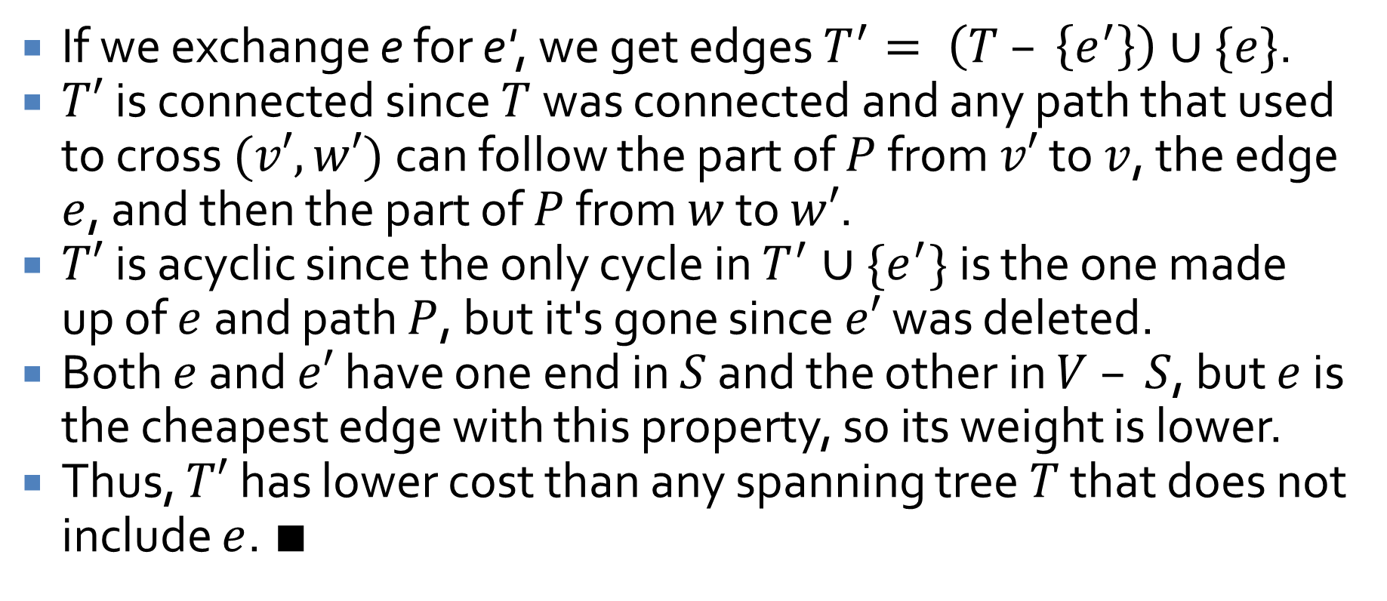
Proof continued
If we exchange e for e', we get edges $T^{′}= \left(T – \left\{e^{′}\right\}\right)∪\{e\}$.
$T′$is connected since $T$ was connected and any path that used to cross $(v′, w′)$can follow the part of $P$ from $v′$ to $v$, the edge $e$, and then the part of $P$ from $w$ to $w′$.
$T′$is acyclic since the only cycle in $T^{′}∪\{e^{′}\}$ is the one made up of $e$ and path $P$, but it's gone since $e′$ was deleted.
Both $e$ and $e′$ have one end in $S$ and the other in $V – S$, but $e$ is the cheapest edge with this property, so its weight is lower.
Thus, $T′$has lower cost than any spanning tree $T$ that does not include $e$. ∎

Slide 8
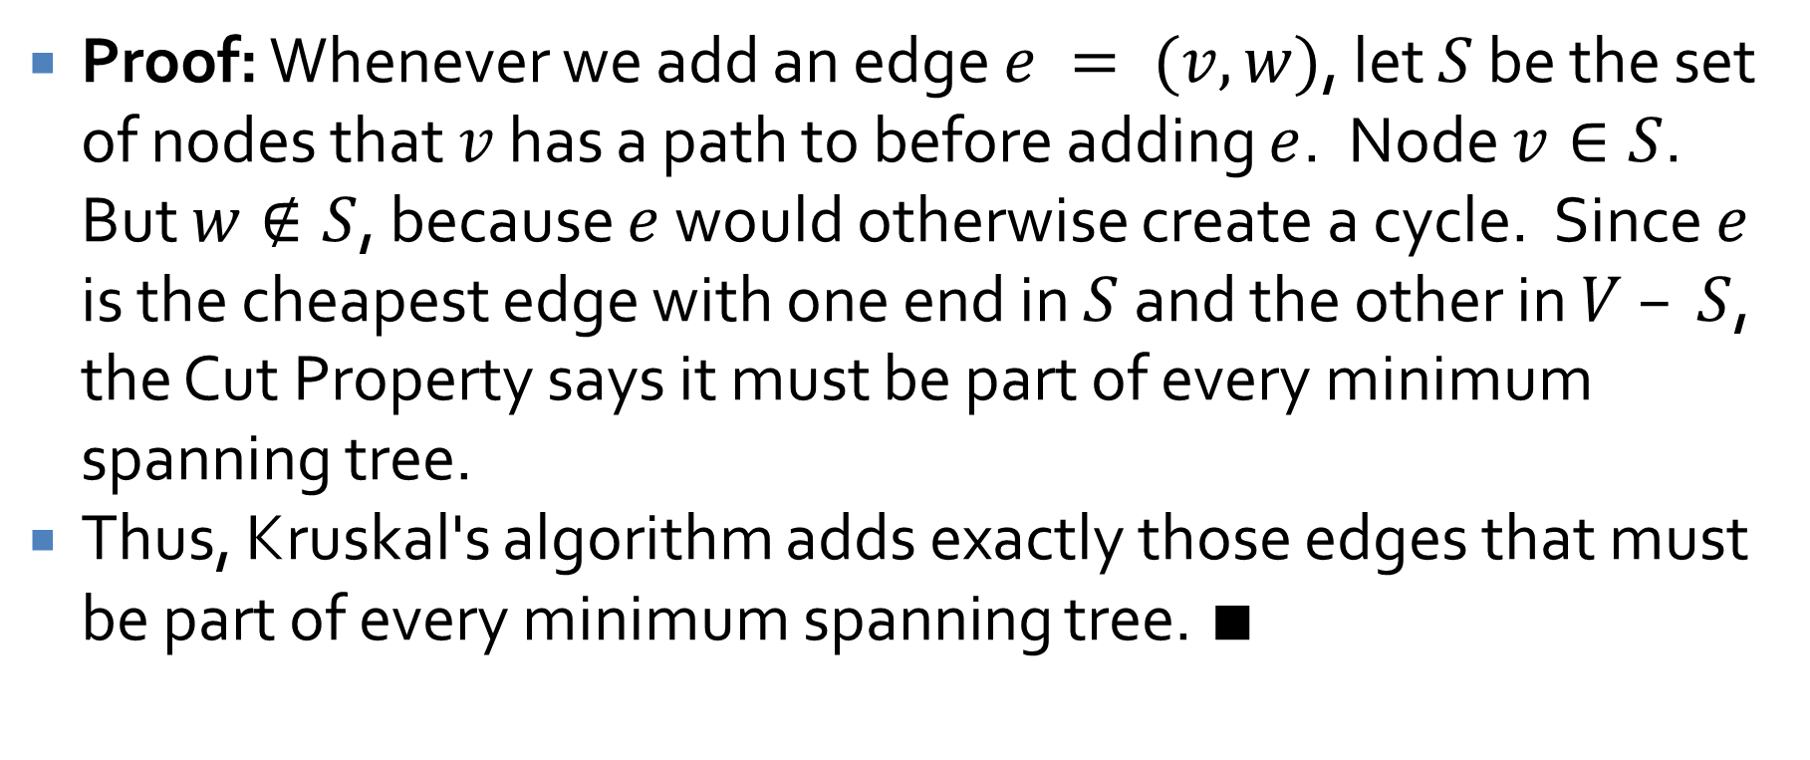
Kruskal's algorithm produces an MST
Proof: Whenever we add an edge $e = (v, w)$, let $S$ be the set of nodes that $v$ has a path to before adding $e$. Node $v∈S$. But $w∉S$, because $e$ would otherwise create a cycle. Since $e$ is the cheapest edge with one end in $S$ and the other in $V – S$, the Cut Property says it must be part of every minimum spanning tree.
Thus, Kruskal's algorithm adds exactly those edges that must be part of every minimum spanning tree. ∎

Slide 9

Cycle Property
Assume that all edge costs are distinct. Let $C$ be any cycle in $G$, and let edge $e = (v,w)$ be the most expensive edge in $C$. Then $e$ does not belong to any minimum spanning tree of $G$.

Slide 10
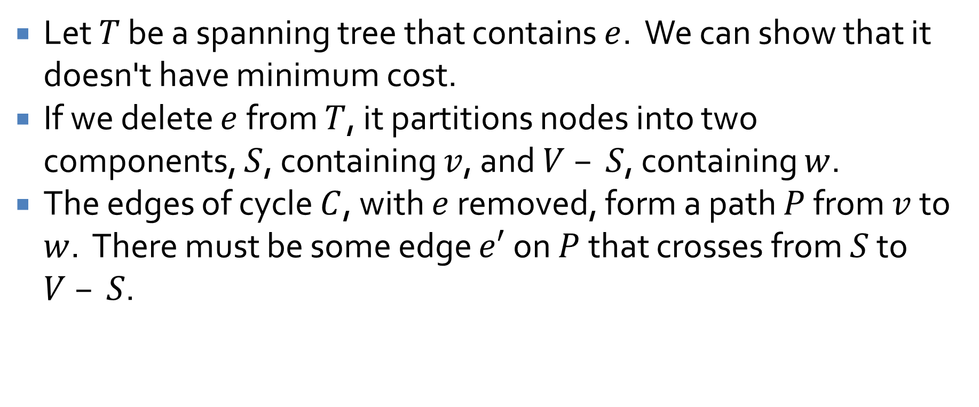
Proof of Cycle Property
Let $T$ be a spanning tree that contains $e$. We can show that it doesn't have minimum cost.
If we delete $e$ from $T$, it partitions nodes into two components, $S$, containing $v$, and $V – S$, containing $w$.
The edges of cycle $C$, with $e$ removed, form a path $P$ from $v$ to $w$. There must be some edge $e′$on $P$ that crosses from $S$ to $V – S$.

Slide 11
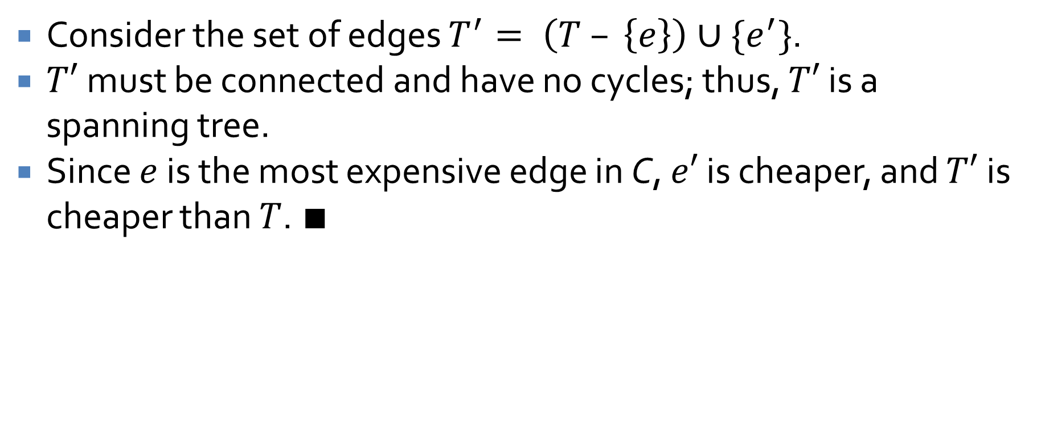
Proof continued
Consider the set of edges $T^{′}= \left(T – \left\{e\right\}\right)∪\{e^{′}\}$.
$T′$must be connected and have no cycles; thus, $T′$ is a spanning tree.
Since $e$ is the most expensive edge in C, $e′$ is cheaper, and $T′$is cheaper than $T$. ∎

Slide 12
MST reflections
Using the Cut Property, it's easy to show the correctness of Prim's algorithm
Using the Cycle Property, it's easy to show the correctness of the Reverse Kruskal's algorithm
It turns out that any algorithm that follows the Cut Property to add edges to a spanning tree or any algorithm that follows the Cycle Property to remove edges from a graph (or any combination of the two) will find an MST

Slide 13
What about when some edges have the same cost?
In all MST algorithms, if there is a choice between edges with the same cost, either can be chosen
  Provided that connectivity/cycle constraints are met
A way to demonstrate this is to add tiny random amounts to the weights of all edges, much smaller than the difference between any non-equal cost edges
These random changes serve as tie-breakers between edges of the same cost
  However, they will not change the structure so that larger edges would have been chosen

Slide 14
Review

Slide 15
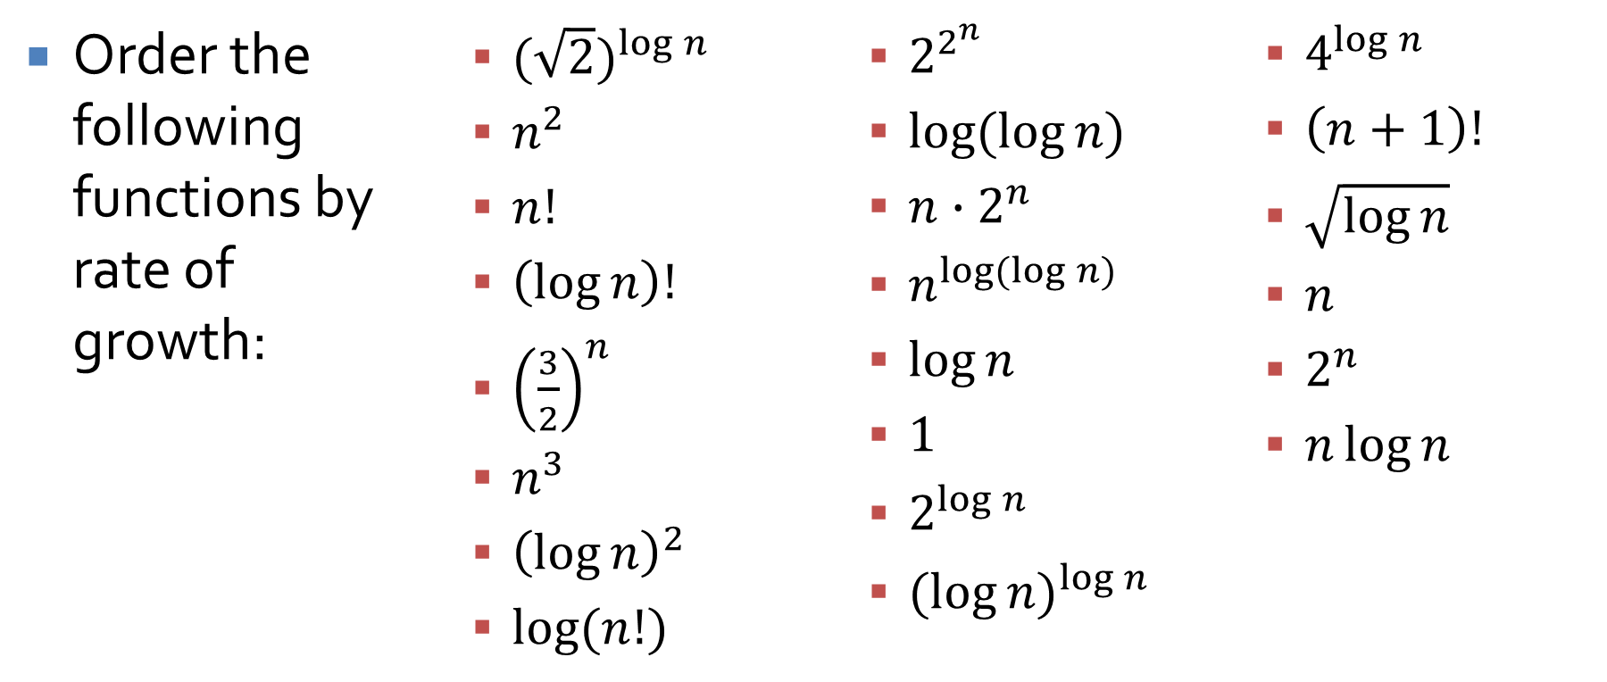
Big Oh
Order the following functions by rate of growth:
  ${(\sqrt{2})}^{\log{n}}$
  $n^{2}$
  $n!$
  $\left(\log{n}\right)!$
  ${\left(\frac{3}{2}\right)}^{n}$
  $n^{3}$
  ${\left(\log{n}\right)}^{2}$
  $\log{(n!)}$
  $2^{2^{n}}$
  $\log{(\log{n})}$
  $n{∙2}^{n}$
  $n^{\log{(\log{n})}}$
  $\log{n}$
  $1$
  $2^{\log{n}}$
  ${(log{n)}}^{\log{n}}$
  $4^{\log{n}}$
  $\left(n+1\right)!$
  $\sqrt{\log{n}}$
  $n$
  $2^{n}$
  $n\log{n}$

Slide 16
Big Oh
Determine the running time of various loops
Example:
  int counter = 0;
  for(int i = 0; i < n*n; ++i)
  for(j = 1; j <= i; ++j)
  counter++;

Slide 17
Graphs
Know basic definitions of graphs
  Nodes
  Edges
  Directed vs. undirected
  Adjacency matrix vs. adjacency lists
  Trees
  Connected
  Strongly connected

Slide 18
Graph algorithms to know
BFS
DFS
Determining bipartiteness
Find connected components
Find strongly connected components
Topological sort

Slide 19

Example proof
For all $n∈ℤ$, if $n^{3}+ 5$ is odd, then $n$ is even.
Hint: Try a proof by contradiction.

Slide 20
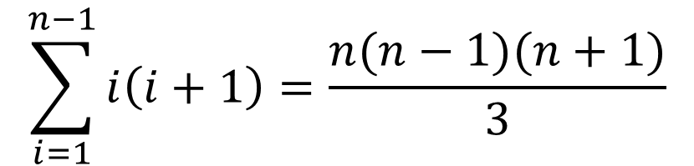

Example proof
Prove that, for all integers $n  2$,
Hint: Try a proof by induction.
$$\sum_{i=1}^{n−1}{i\left(i+1\right)=\frac{n(n−1)(n+1)}{3}}$$

Slide 21

Example proof
Prove that, for all integers $n  1$,
$$\frac{\sum_{i=1}^{n}{2i−1}}{\sum_{i=1}^{n}{2n+2i−1}}=\frac{1}{3}$$
Hint: Try a proof by induction.

Slide 22

Example proof
Prove that a graph with two or more nodes where each node has a degree of $\frac{n}{2}$ or higher must be connected.
Hint: Try a proof by contradiction.

Slide 23
Upcoming

Slide 24
Next time…
Exam 1!

Slide 25
Reminders
Finish Assignment 2
  Due tonight before midnight
Review chapters 1 through 3

